Slide 1
Lecture 8 – Object Structuring
COMP 3700: Modeling and Design
Chapter 8: Object Structuring
Gomaa, 2011

Slide 2
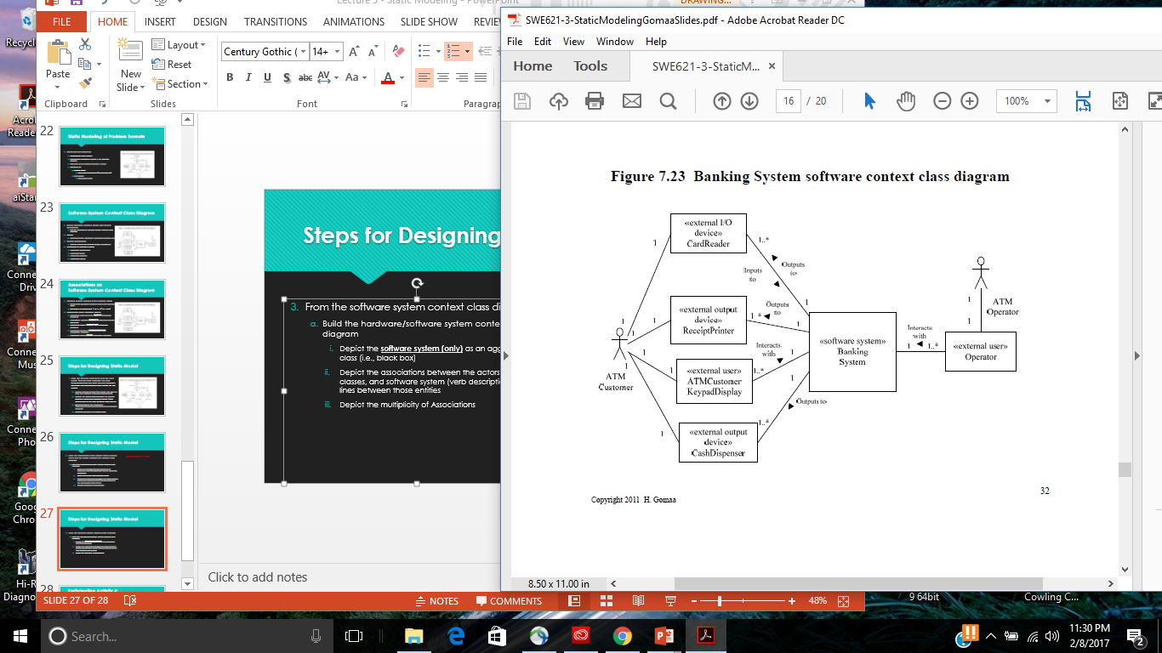
Entity Classes
Data intensive classes
Store long-living data (persistent)
Especially important for Information Systems
Many are database intensive
Also important for many real-time and distributed applications
COMET approach emphasizes static modeling of entity classes
During analysis modeling
Model entity classes in the problem domain
Attributes
Relationships

Slide 3
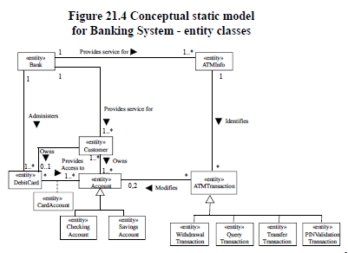
Moving into the Black Box
This phase focuses on understanding the problem domain/description from the perspective of the software
Understanding entities of the software that are likely not to change.
Start from the problem description
Identify static (i.e., unlikely to change) entities identified in the problem description
Model them as classes with the stereotype <<entity>>
Depict the associations between the entity classes (verb descriptions on the lines) between those classes
Depict the multiplicity of associations
For each class, describe attributes and attribute types using class UML notation

Slide 4
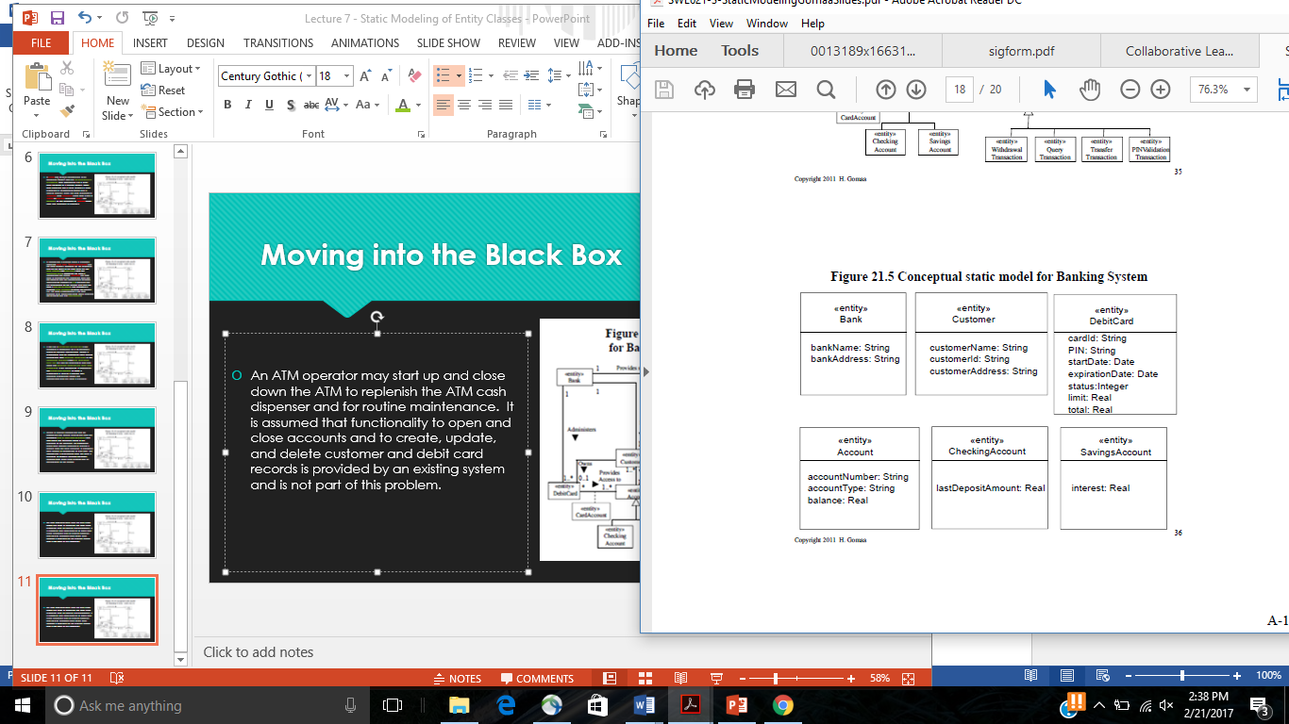
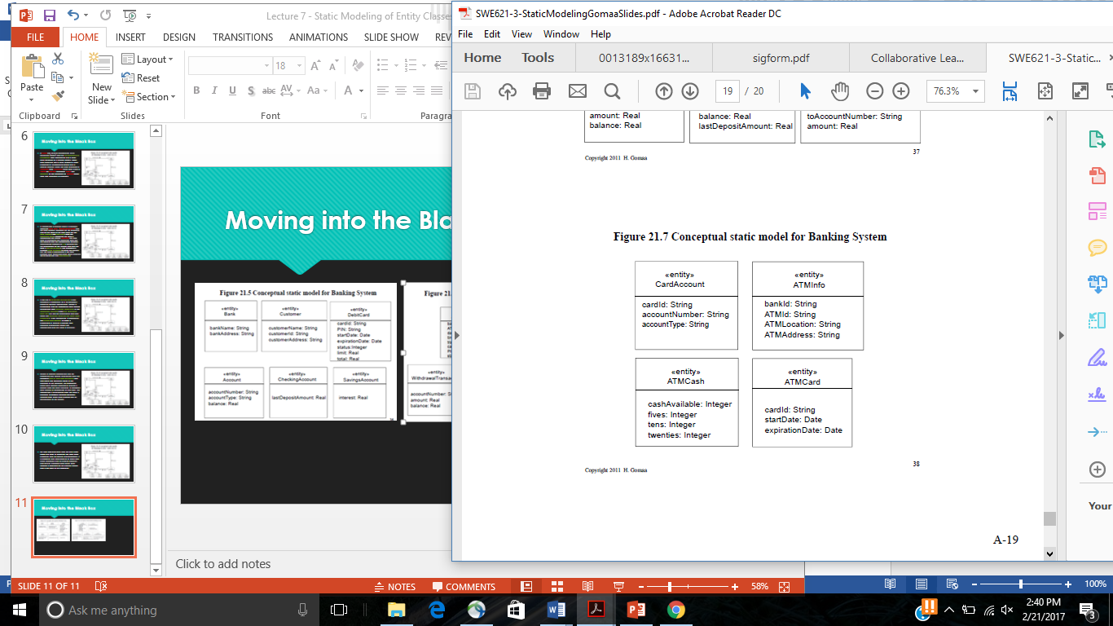
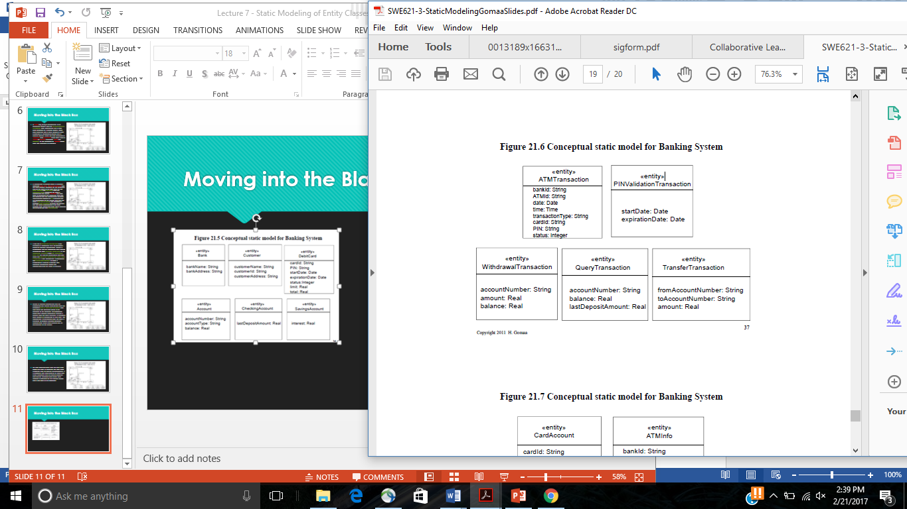
Moving into the Black Box

Slide 5
Participation Activity 6 Entity class diagram and class attributes
Remaining in in-class groups, create the entity class diagram for the software system depicted as a black box in your software context class diagram
Upload into Canvas
Entity class diagram with stereotypes
UML classes with class attributes (including types) with stereotypes
Reminder: Exam 2 is Thursday (2/23) in class

Slide 6
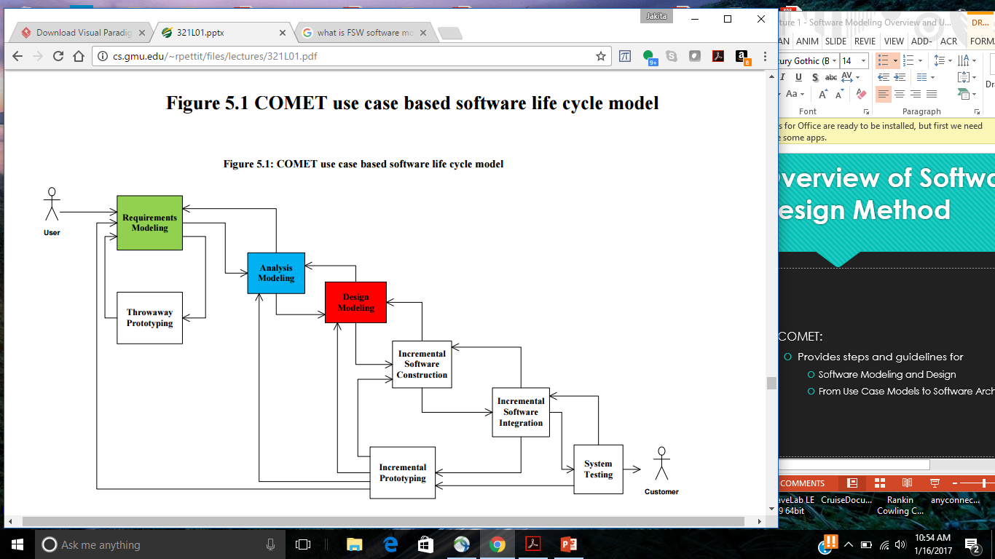
COMET Use Case Based Software Life Cycle Model
Develop Software Requirements Model
Develop Use Case Model (Chapter 6)
Develop Software Analysis Model
Develop Static model of problem domain (Chapter 7)*
Structure system into objects (Chapter 8)
Develop statecharts for state dependent objects (Chapter 10)
Develop object interaction diagrams for each use case (Chapter 9, 11)

Slide 7
Object Structuring Criteria
Determine all software objects in system
Use Object Structuring Criteria
Guidelines for identifying objects
Structuring criteria depicted using stereotypes
Stereotype defines a new building block that is derived from an existing UML modeling element but is tailored to the modeler’s problem
Depicted using guillemets
<<entity>>, <<boundary>>, <<control>>
Objects are categorized
A category is specifically defined division in a system of classification

Slide 8
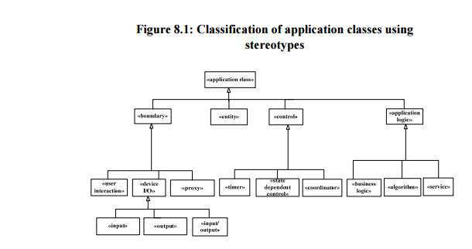
Object Structuring Criteria
Boundary objects
User interaction object
Device I/O object
Proxy object
Entity objects
Long living objects that store information
Determined during static modeling
Control objects
Application Logic Objects

Slide 9
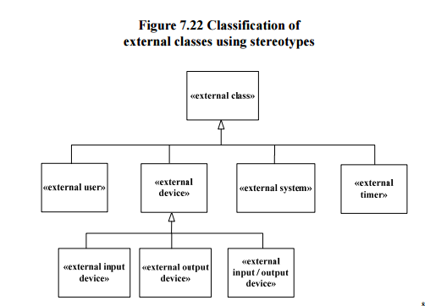
Object Structuring Criteria
Boundary objects
Interface to and communicate with external environment
Each software boundary object interfaces to an external (real-world) object
Use interaction object
Device I/O object
Proxy object
For each boundary object there is a corresponding external object
Also depicted using stereotype

Slide 10
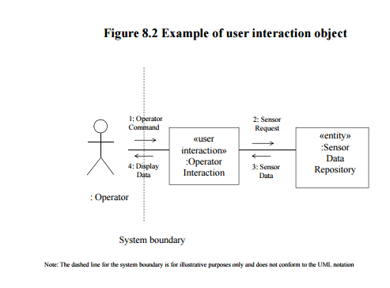
Boundary Objects
User interaction object
Interface to and interacts with a human user
Via standard I/O devices
Keyboard, visual display, mouse, etc.
Support simple or complex user interfaces
Command line interface
Graphical user interface (GUI)

Slide 11

Boundary Objects
Proxy object
Interfaces to an external system
Hides details of how to communicate with external system
For example, Robot Proxy interfaces to external (real-world) robot

Slide 12

Boundary Objects
Device I/O boundary object
Interfaces to I/O device
Input object
For example, Sensor Interface
Output object
For example, Actuator Interface
I/O (Input/Output) object
For example, ATM Card Reader Interface

Slide 13
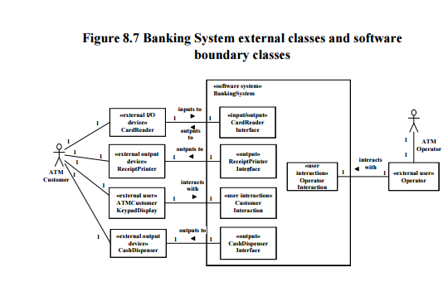
Depicting External Classes and Boundary Classes
Start from system context class diagram
Depict boundary classes (NOTE: each external class must interface to software boundary class)
Depict relationship(s) between external classes and boundary classes
Describe the associations between external class(es) and boundary class(es) (i.e., verbs on the lines)
Depict multiplicity of associations

Slide 14
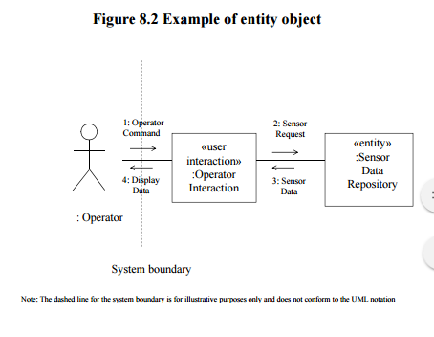
Object Structuring Criteria
Entity objects
Long lasting objects that store information
Same object typically accessed by many use cases
Information persists over access by several use cases
For example: Account, Customer
Entity classes and relationships shown on static model
Entity classes often mapped to relational database during design

Slide 15
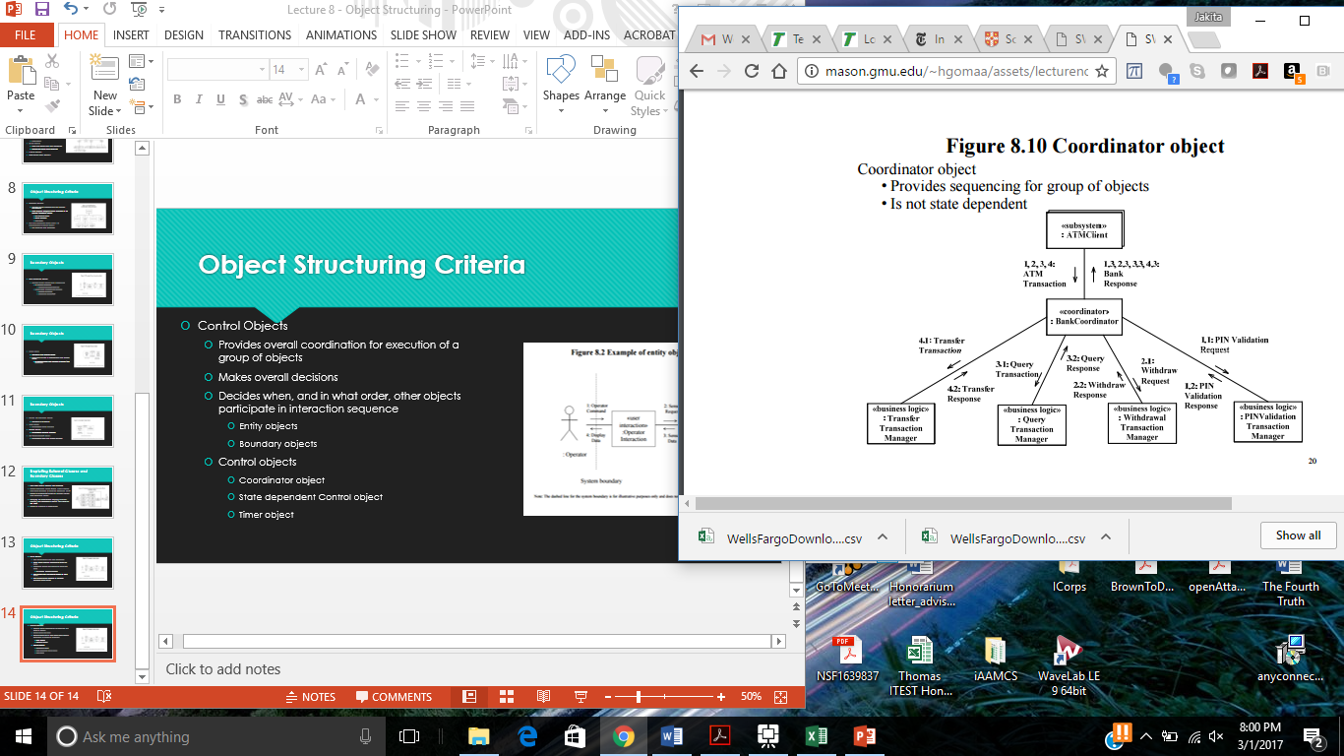
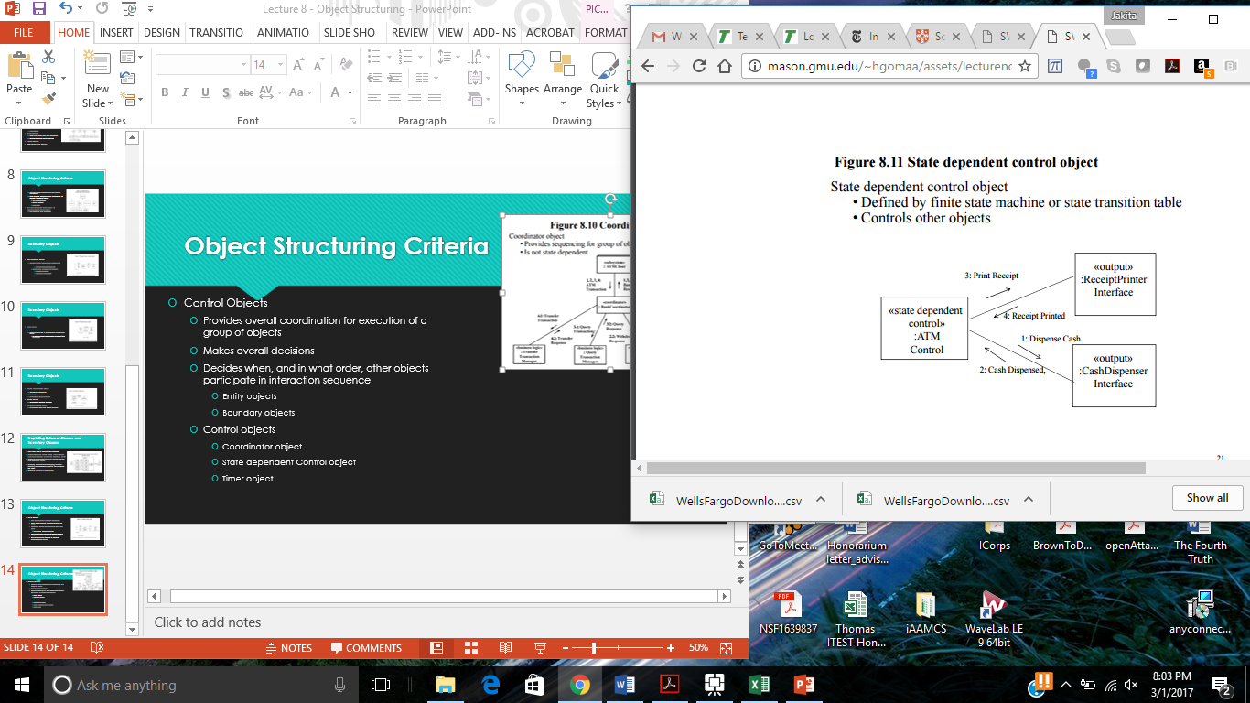
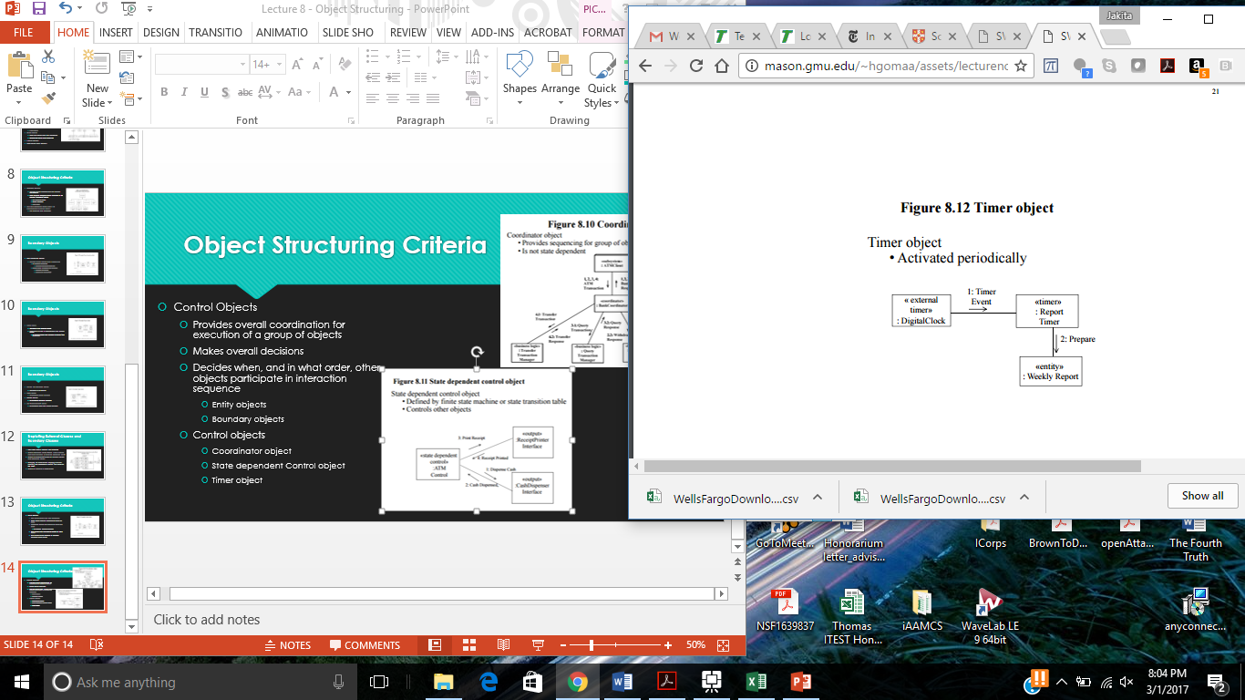
Object Structuring Criteria
Control Objects
Provides overall coordination for execution of a group of objects
Makes overall decisions
Decides when, and in what order, other objects participate in interaction sequence
Entity objects
Boundary objects
Control objects
Coordinator object
State dependent Control object
Timer object

Slide 16
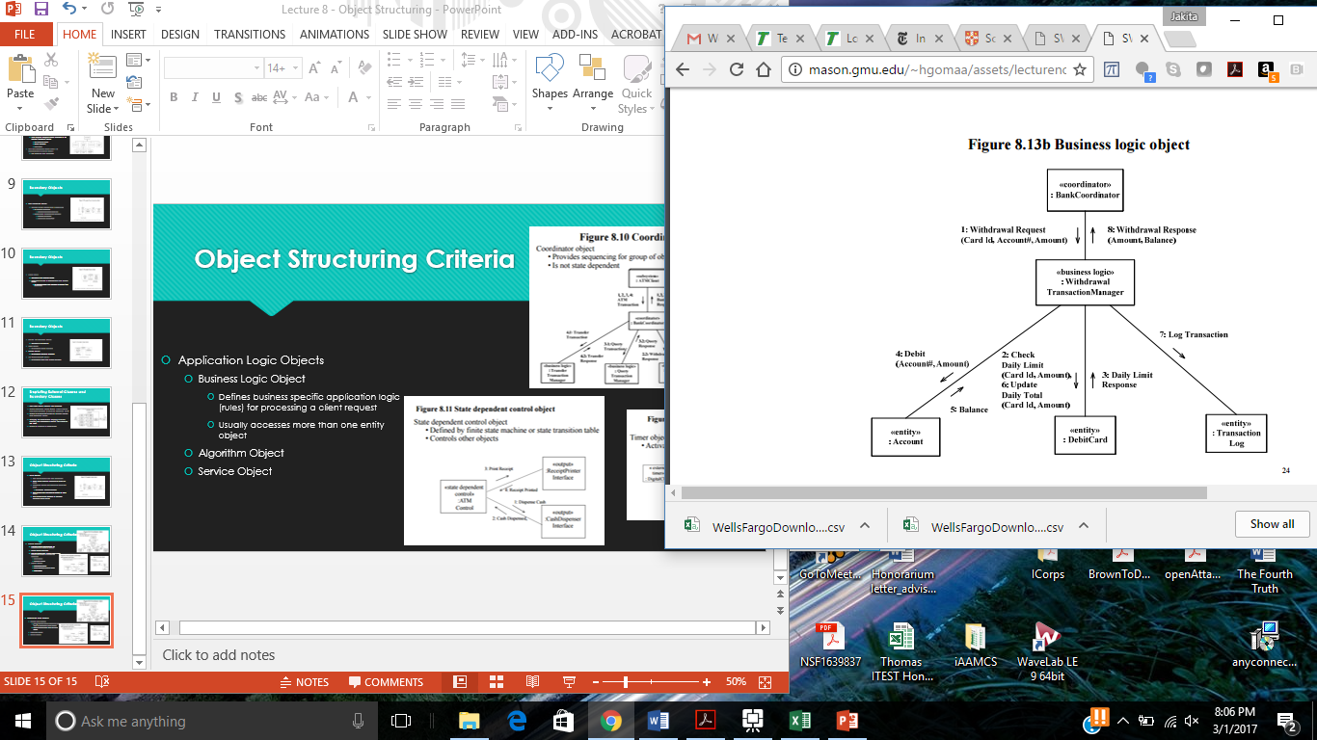
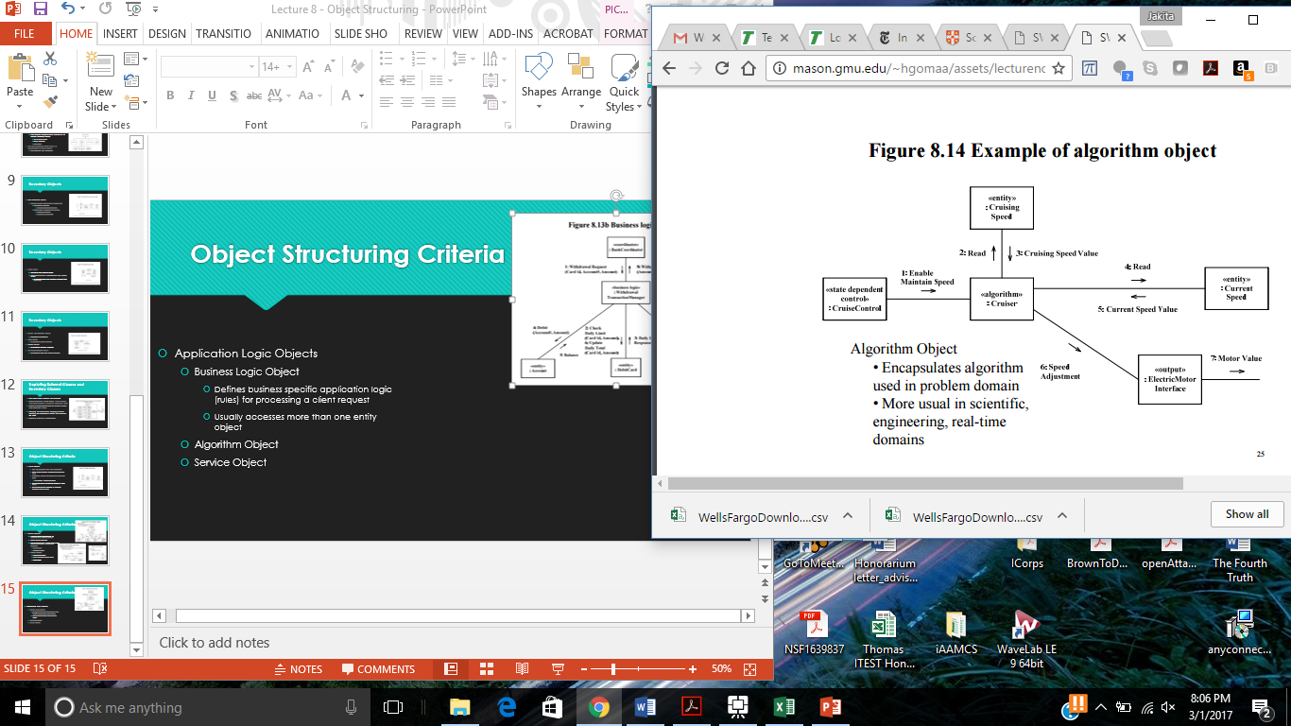
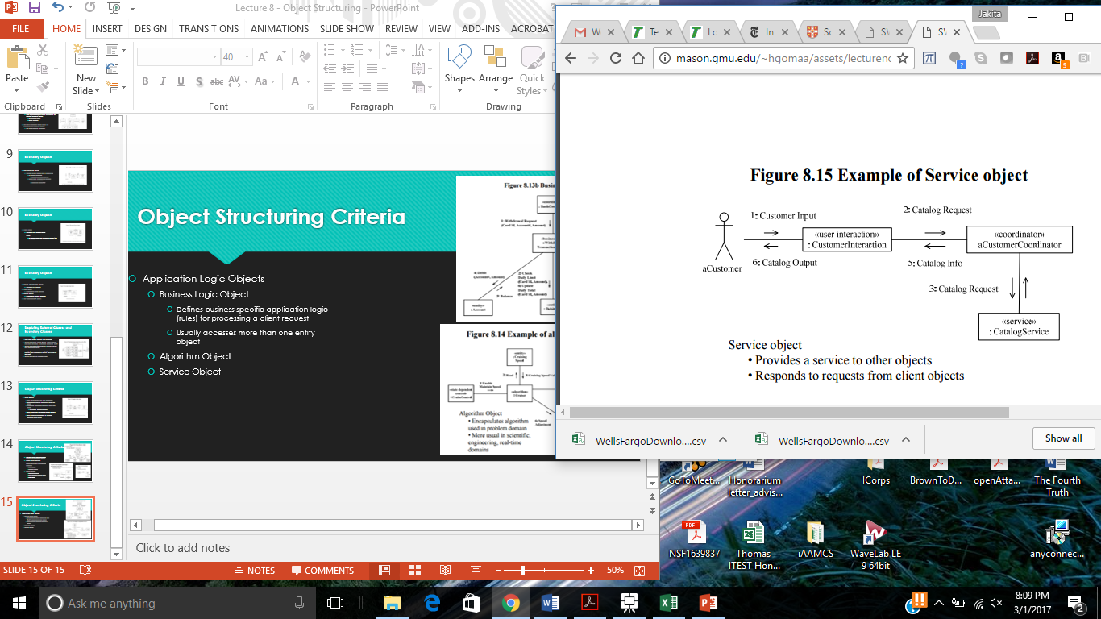
Object Structuring Criteria
Application Logic Objects
Business Logic Object
Defines business specific application logic (rules) for processing a client request
Usually accesses more than one entity object
Algorithm Object
Service Object

Slide 17
COMET Use Case Based Software Life Cycle Model
Develop Software Requirements Model
Develop Use Case Model (Chapter 6)
Develop Software Analysis Model
Develop Static model of problem domain (Chapter 7)*
Structure system into objects (Chapter 8)
Develop statecharts for state dependent objects (Chapter 10)
Develop object interaction diagrams for each use case (Chapter 9, 11)

